Slide 1

Introduction to Cultural Data Science
Final project presentation
Louise Brix Pilegaard Hansen

Slide 2






Exploring topics and/or moods of current popular music
More exploratory analysis
Analyzed using Natural Language Processing Tools
Topic Modelling
Sentiment Analysis
If time/space: compare differences across time or across genres
What?
Notes:
Explain what topic modelling (and also briefly what sentiment analysis) is
Topic modelling: a tool to discover hidden topics in text/documents by clustering words that are similar to each other → can shed light on the themes of large amounts of unstructured text

Slide 3




Why?
Through streaming services like Spotify (456 million users worldwide) (Spotify, n.d.), popular music has become easily accessible
Lyrics have been found to influence people’s social relationships, emotions and behaviour (Council on Communications and Media, 2009)
Lyrics can reflect which themes and topics are relevant at the moment
→ Interesting to look at what defines the topics and moods of today’s popular music

Slide 4


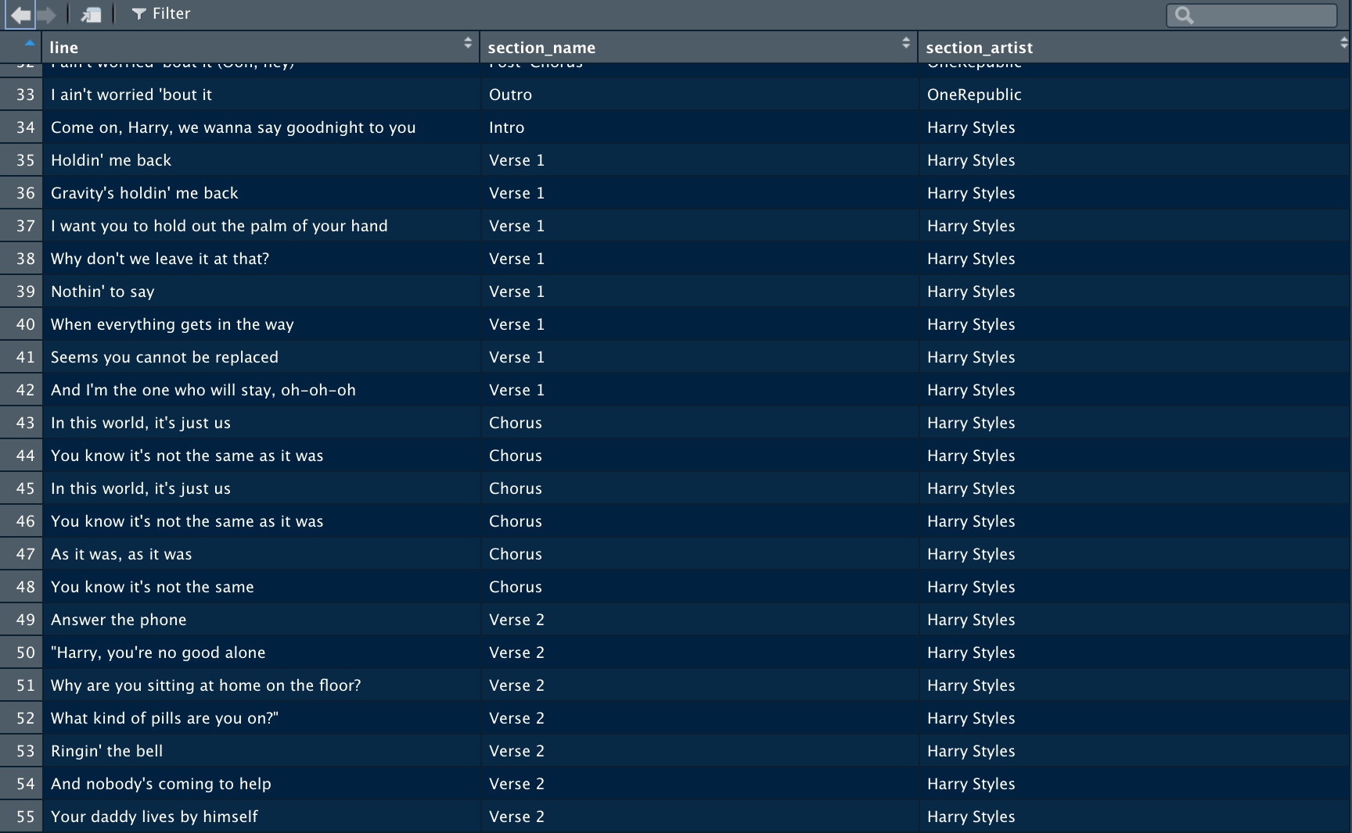


How?
Use Spotify API to extract data from Global Hit Charts
Python package Spotipy
Use Genius API to scrape lyrics from genius.com
R package geniusr
Packages and methods for Topic Modelling/Sentiment analysis TBD
Possibilities: NRC, VADER, LDA
Notes:
API: Short for Application Programming Interface
LDA: Topic modelling method;

Slide 5
Sources
Council on Communications and Media. (2009). From the American Academy of Pediatrics: Policy statement--Impact of music, music lyrics, and music videos on children and youth. Pediatrics, 124(5), 1488–1494. https://doi.org/10.1542/peds.2009-2145
About Spotify. (n.d.). Spotify. https://newsroom.spotify.com/company-info/

